Slide 1
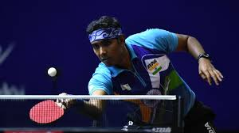
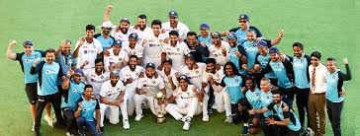
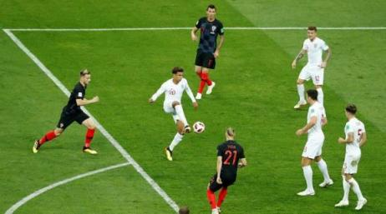
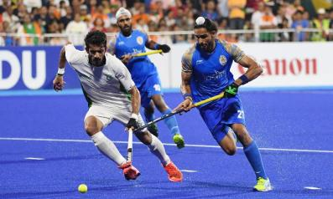
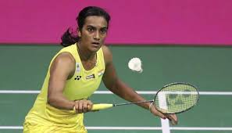
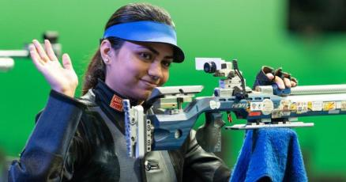
Eumind Regions: Sports
Group 1

Slide 2
CAMPION SCHOOL
SCHOOL
Campion School is Jesuit Institution, founded by Father Joseph Savall in 1943.
Campion has 35 teachers, teaching over 800 students who supported by a support staff consisting of 50 helpers.
Campion’s students are divided into 4 houses: Britto (Red), Loyola (White), Xavier (Blue), and Berchman (Yellow); and classes from Junior KG till 10th grade.
In Campion, many subjects are taught: English, Hindi, Marathi, Science (Chemistry, Biology, Physics), Mathematics, Social Studies (History, Geography), Physical Training, Physical Biology, Commercial Applications, Computer Studies, and Technical Drawing.
Campion’s motto is “JOY IN TRUTH”.

Slide 3
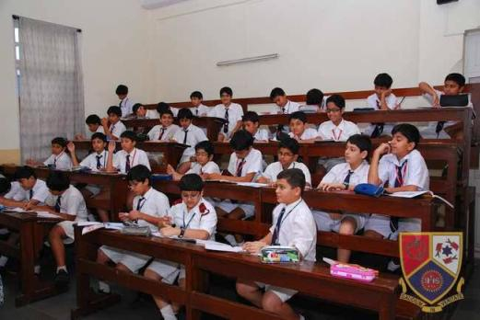
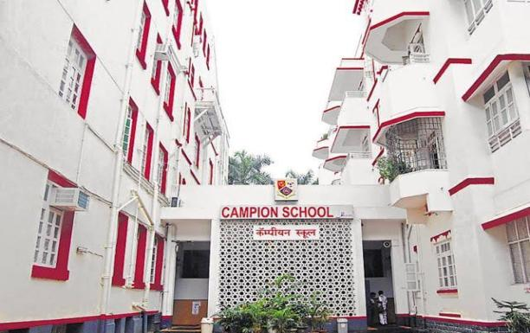
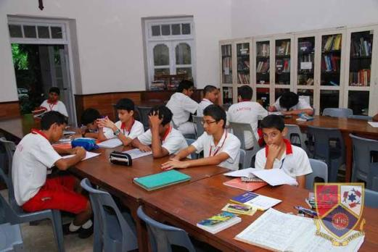
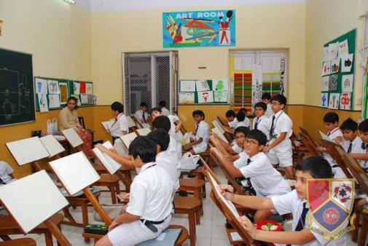

Slide 4
India
REGION
India is located in south Asia.
It is the 2nd most populated country in the world, as well as the most populous democracy in the world, with a population of about 1.37 billion people.
India is a very youthful country: almost 50 percent of the people are under 25 years old.
It is the 7th largest country in the world, with a surface area of 3.287 million sq. kilometres.
Though its economy is growing fast, India is still a very poor country. 68.8 precent of Indians get by on less than US $2 every day.
It is an incredibly diverse country, with many, many religions practised by its population.
In particular over 450 native languages are used in India.

Slide 5
Introduction
INTRODUCTION
According to the Google Dictionary, sports are “physical games or activity that you do for exercise or because you enjoy it.”
Note that this definition encompasses both competitive sports as well as physically active informal recreational play.
Sports are of particular importance to youth, especially children. Study after study establishes that children and adolescents who play sports are much likelier than their counterparts to grow into active, healthy adults. Children who play sports also perform academically better than their peers. They are also, on the average, socially better adjusted than more sedentary children. Finally sports are just plain fun, and contribute significantly to the joy of childhood.
In this project we will study the availability of sports and training facilities in India, with emphasis on Mumbai city. We will also address the related question of how we can improve the situation.
As part of our project we also include some interviews of people, such as a senior sports journalist, teachers from Campion, and even some of our school mates, asking them what they think about the situation.

Slide 6
Sports Played In India
INTRODUCTION
As is true all over the world, Indian children engage in a wide variety of informal sporting play, ranging from simple games like catching cook and ‘seven tiles’ to more formal games like football and cricket.
At the more organized level a wide variety of sports are played in India, ranging from mainstream to indigenous sports.
The most popular game is definitely cricket. At the top levels’ cricket is a highly competitive sport played with expensive equipment in multi million dollar stadia. Indian children, however, have also converted cricket into a joyful low cost informal activity with millions of matches played every day in by-lanes and patches of waste land, using inexpensive bats and improvised balls.
Other widely played mainstream sports include football, hockey, badminton, lawn tennis, table tennis, shooting, wrestling, cycling, gymnastics, swimming, weightlifting and many many more.
In addition there are also many indigenous sports, such as kho-kho, kabaddi, kite fighting, and gillidanda.
The highest award given by the government to a sportsperson is the Rajiv Gandhi Khel Ratna.

Slide 7
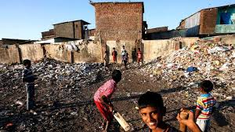
Fig 1. Slum Children Playing Cricket on a patch of Waste Land

Slide 8
Are there enough sports facilities available for each group of society?
Main Question:

Slide 9
Recreational Sporting facilities in India
MAIN QUESTION
In most Indian cities the majority of children lack access to facilities for even the simplest informal recreational activities.
Most urban Indian schools, for instance, do not have a dedicated play ground. Several schools are housed in converted residential buildings; their students display extreme innovation in coming up with games they can play in their cramped surroundings, but even this remarkable ingenuity, of course, has its limitations.
The situation at home is even worse for most children. Over 50 percent of Mumbai, for instance, lives in informal shanty housing complexes often called slums. A family of 6 often lives in a single 30 square metre room. Hutments crowd against each other, and open out into very narrow pathways. Children who live in these slums lack the basic requirement for physical recreation – a minimal space in which to play in the neighbourhood of their homes.

Slide 10
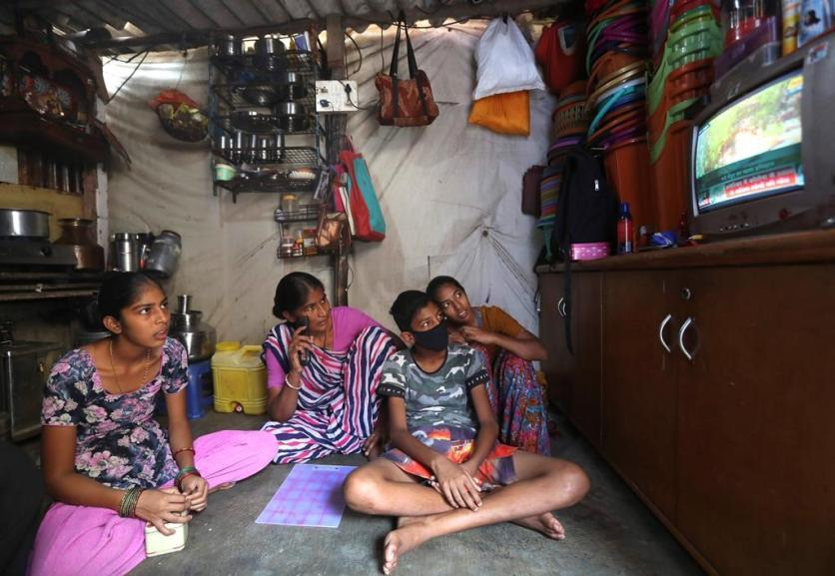
Fig 2. People watching cricket in a slum

Slide 11
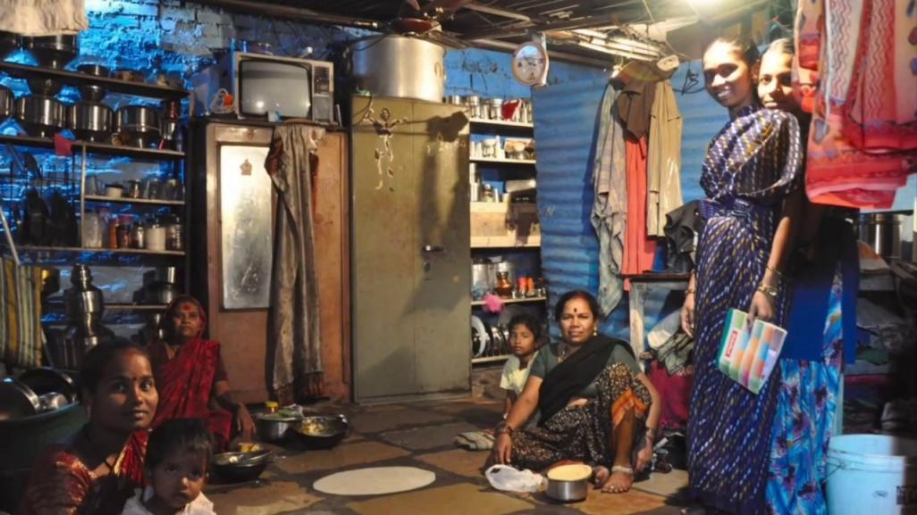
Fig 3. The inside of a Slum

Slide 12
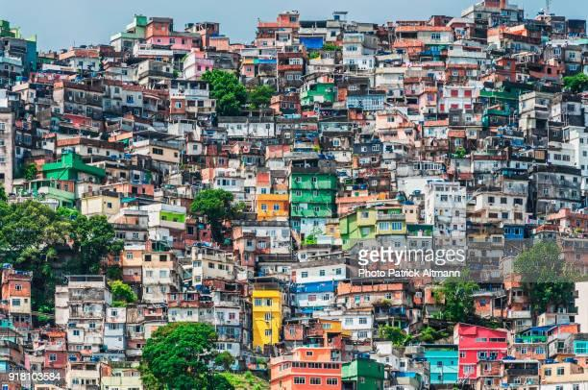
Fig 4. A Cluster of Slums

Slide 13
Recreational Sporting facilities in India
MAIN QUESTION
The situation is somewhat remedied by the fact that many Indian cities have Maidans; wide open, often grassy spaces, dedicated to recreational activity, maintained by the city. Maidans are freely accessible to everyone, and are sporting lifelines. The three famous maidans of South Mumbai – Oval Maidan, Cross Maidan and Azad Maidan – form an integral part of the childhood of every sporting minded Mumbaikar. These maidans are used equally by slum dwellers and middle class students like those from my school Campion.
There are also public parks and gardens around the country in most major cities, that do have some, very basic exercising equipment for people to use. This equipment is of good quality, but since many people use it, they are a bit worn down. (See Fig 2. Slide 10)
Of course the situation is much better for the rich, who usually have memberships at sporting recreational clubs which offer a wider range of world class sporting facilities to their members. Only a small minority of our city residents, however, are able to afford such memberships.

Slide 14
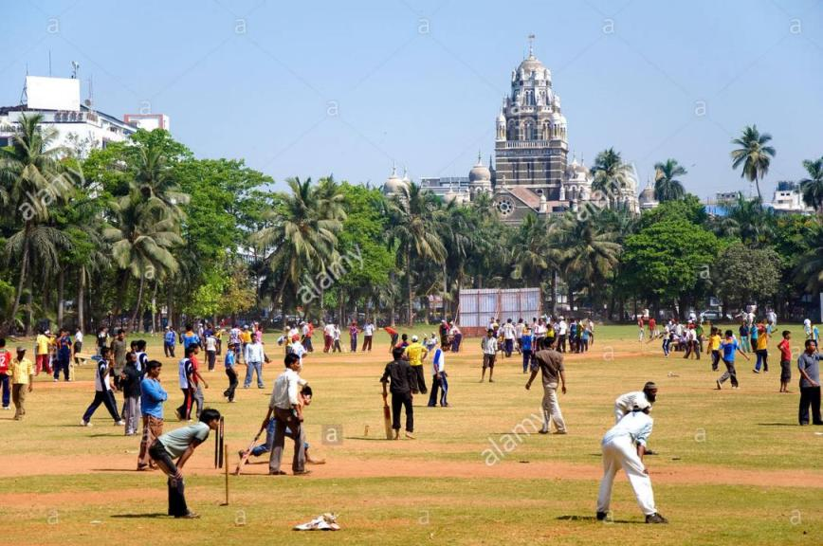
Fig 5. Oval Maidan on a normal day.

Slide 15
FORMAL SPORTING FACILITIES IN INDIA
MAIN QUESTION
Given the situation with basic recreational facilities reviewed above, it will come as no surprise to the reader that ordinary Indians find it very hard to access adequate sporting and coaching facilities for formal competitive sports.
Only a small minority of urban Indian children ever undergo formal coaching for any sport at all. Even fewer have access to swimming pools.
However the situation is better for students who are somehow identified as having exceptional sporting talent. The Sports Authority of India (SAI) runs 56 Sports Training Centres (STC)s around the country. Youth who are identified as having exceptional promise receive scholarships and free coaching at these institutions. While the equipment and hygiene levels at the STCs are not exactly world class, they at least represent an institutional opportunity for sportspeople from very ordinary backgrounds to realize their potential (See Fig 1. Next Slide).

Slide 16
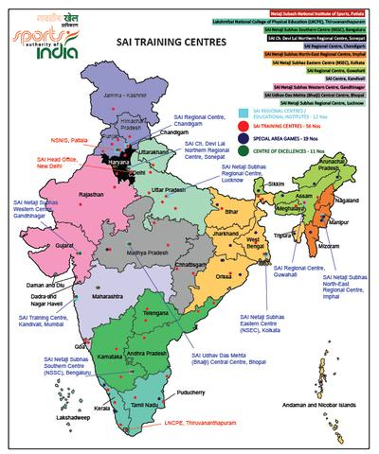
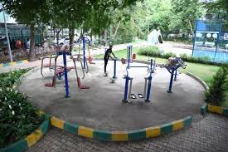
Fig 7. Public Exercising Equipment
Fig 6. SAI Training centres across the country.

Slide 17
FORMAL SPORTING FACILITIES IN INDIA
MAIN QUESTION
At the top level, the situation is better in the sport of cricket.
The Board of Cricket Control in India (BCCI) runs an absolutely top quality `National Cricket Academy (NCA)’. Aimed at training young cricketers who are identified as having the potential to represent the Indian cricket team. The NCA is currently headed by Rahul Dravid, the legendary Indian batsman, and has been hugely successful in identifying and training promising cricketers from very ordinary backgrounds.
The historic recent victory of the Indian cricket team in a tour of Australia was made possible by the stellar performances of graduates of the NCA like T. Natarajan (the son of a roadside street food seller) and Mohammad Siraj (the son of an auto rickshaw driver), players who would never had been able to make it to international cricket had the NCA not existed.
However institutions like the NCA and even the STCs, are few and far between, and can only be accessed by exceptionally talented sports people.

Slide 18
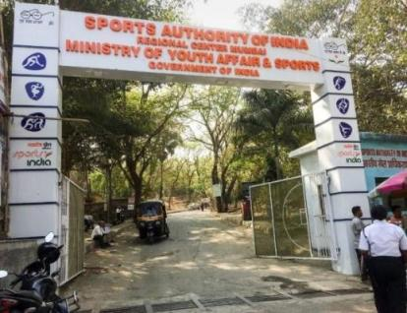
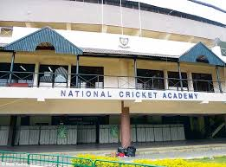
Fig 8. The SAI Training Centre in Mumbai
Fig 9. The National Cricket Academy in Bangalore

Slide 19
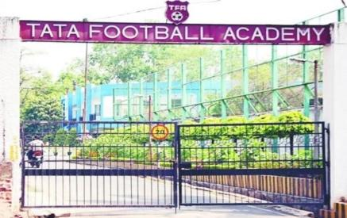
FORMAL SPORTING FACILITIES IN INDIA
MAIN QUESTION
Even in football, India has a very good training centre, the Tata Football Academy (TFA), in Jamshedpur.
This facility plays a huge role in training good football players from small cities and villages.
It is one of the best football academies in India.
Many of its graduates have represented India at the biggest stage.
The Tata Football Academy (TFA) is set to be renamed as Tata Atletico Football Academia after the Tata Trusts joined hands with La Liga giants, Atlético Madrid, to enhance and strengthen its existing programmes for promoting Indian football.
Fig 10. The Tata Football Academy

Slide 20
FORMAL SPORTING FACILITIES IN INDIA
MAIN QUESTION
As always, the situation with respect to formal sports training is much better for the well off.
Private, for profit sports training centres normally have good equipment, and their training is on the whole very good.
However these training centres are expensive and so out of reach for normal Indians.
For example, to sign up for a really good cricket coaching in Mumbai, with a proper pitch and good equipment, it would cost you between about 20,000 and 2-3 lakh rupees a year (approx. 200 – 2000 euros). This is completely outside the budget of a normal citizen in India.

Slide 21
How Do you think the situation can improve?
SUB QUESTION
The only way for ordinary people to gain access to reasonable sporting facilities is for the government to start funding public sports facilities more.
In Mumbai, there is a historic opportunity. Several old cotton mills are in the process of shutting down, freeing up large tracts of land within the city. Moreover, the ‘Bombay Port Trust’ (BPT) also owns large tracts of land in the city, and is currently debating the optimal use for this resource
We propose that the land that is freed up by old mills, as well as a part of BPT land be used by the government to build a huge public recreational and sporting facility. These facilities should have large tracts of open space for recreational purposes as well as top of the line equipment and trainers. This facility will also be maintained by the government. This facility should be aimed especially for the use of schools. All registered Mumbai schools should be given equal opportunity to book facilities at these new centres at a nominal rate. We feel such a scheme would transform the sporting opportunities for young Mumbaikars, greatly enhancing their childhood. A side benefit would likely be the improved performance of India’s national sports teams in international competitions.

Slide 22
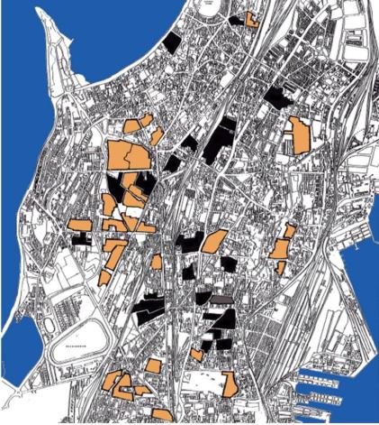
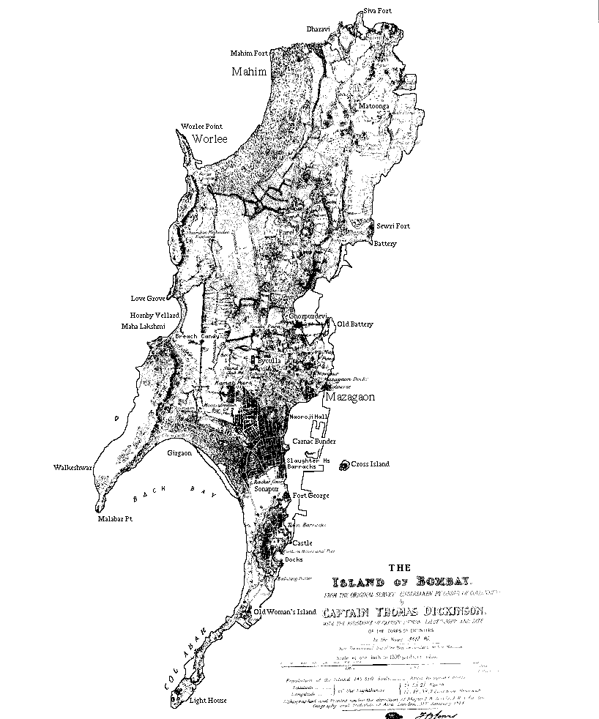
Fig 11 and 12: The location of the old cotton mills that we propose to be converted into sports facilities

Slide 23
How Do you think the situation can improve?
SUB QUESTION
We feel that another solution for this could be modelling on the success of the NCA and STC’s.
The government can start funding more and more institutions like these, so that there are many, for each state and district, so that kids who are good at sports at a school level, can be trained and helped to blossom at these centres.
This could be done in the following for training young cricketers who are identified as having the potential to represent the Indian cricket team. Each Indian state could attempt to establish 50 or so of its own State Sports Training centres (SSTC) and its own State Cricket Academy (SCA). Given that India has 29 states, this simple (and we believe achievable) act would multiply the availability of reasonable sports training and coaching facilities by a factor of about 30, allowing 30 times more ordinary Indian children to benefit.

Slide 25
Conclusion
CONCLUSION
Adequate physical recreational and sporting facilities are essential for a happy and healthy childhood, and lead to a whole host of physical and cognitive benefits in later adulthood.
The sporting facilities for most urban children are inadequate at a very basic level. Most schools lack playgrounds and a majority of urban Indian children lack play space in their neighbourhoods. The situation is somewhat ameliorated by the existence of public maidans in most Indian cities.
Facilities for formal sport training and coaching are even harder to come by. The situation is helped a little by government academies, which, however, are aimed only at exceptional sports people.
We believe the situation can be greatly improved in two ways. First city governments must make an active effort to dedicate space and money to public sports facilities. The city of Mumbai has a historical opportunity in this regard. Second state and national governments must make active efforts to replicate the success of national level sporting academies at the city and district level, to make reasonable quality training accessible to a wider variety of sport loving children.

